Slide 1
Income Over $50K
Cody Pettit

Slide 2
Data
32561 rows
14 variables
Drop missing rows
Less than 2000
age
workclass
fnlwgt
education
education.num
marital.status
occupation
race
sex
capital.gain
capital.loss
hours.per.week
native.country
relationship

Slide 3
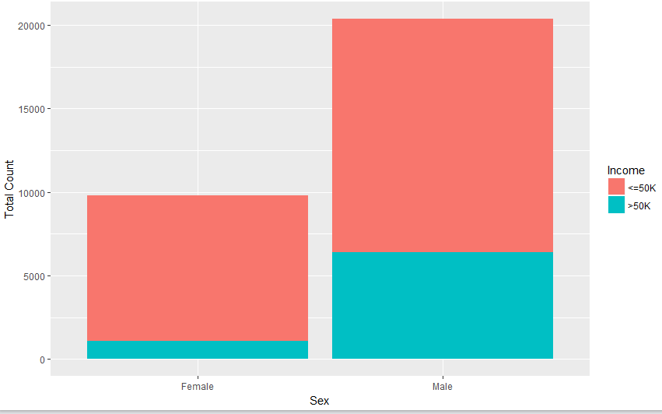
Sex

Slide 4
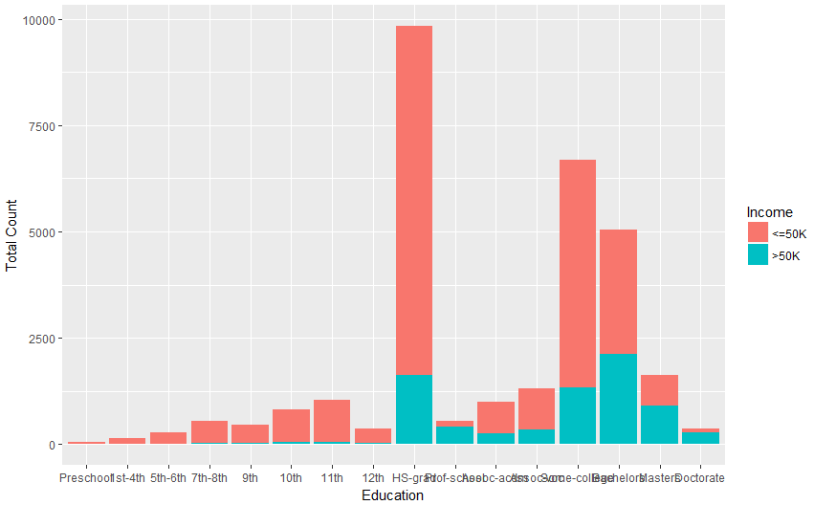
Education

Slide 5
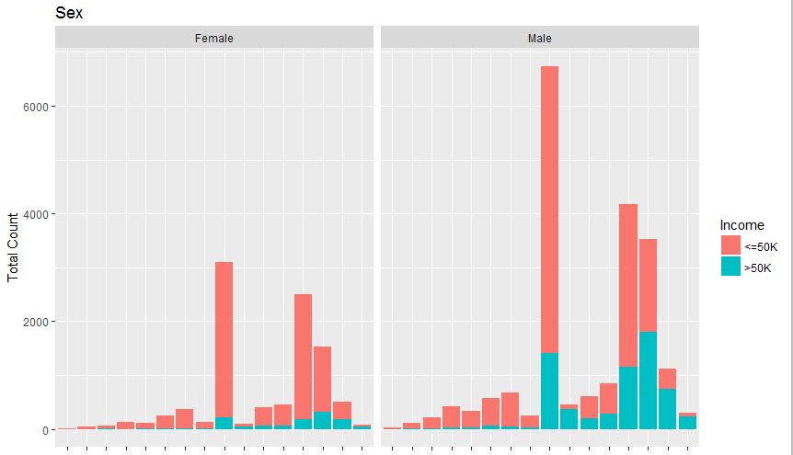
Sex and Education

Slide 6
Results
Several iterations of Random Forest
Best model
Sex, Education, Capital Gain, Capital Loss
 | <=50K | >50K
<=50K | 6617 | 1337
>50K | 179 | 915
Accuracy: 83.24%
Sensitivity: 0.9737
Specificity: 0.4063

